Slide 1
Welcome to
Introduction to Python

Slide 2
Before we get started…
SQL Injection Attacks and Defense
Overview

Slide 3
Module 1: Python Basics

Slide 4
Objectives
SQL Injection Attacks and Defense
Module 1: What is SQL injection?
Upon completion of this lesson, students will be able to do the following:
Explain how Python works.
Understand Python's place in the world of programming languages.
Explain the difference between Python 3.x and Python 2.x.
Identify variables and Python's data types.
Create simple modules.
Access appropriate help on Python.

Slide 5
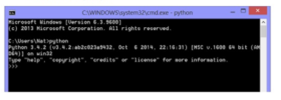
Introduction to Python
Module 1: Python Basics
Running Python
Python Interpreter is necessary to run Python code
Mac or Linux machine already installed
Windows download for free at https://www.python.org/downloads
Open Python Interpreter by typing python at a terminal window or shell prompt

Slide 6
Introduction to Python
Module 1: Python Basics
IDLE
IDLE = Integrated DeveLopment Environment
Type idle at a terminal or shell prompt and press ENTER

Slide 7
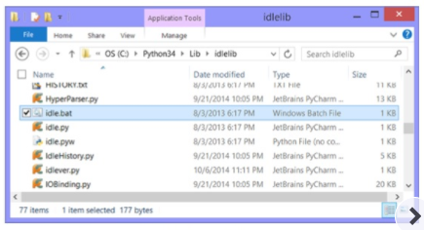
Introduction to Python
Module 1: Python Basics
IDLE (cont.)
You can navigate to the Python directory by
Open the Lib folder
Open the idlelib folder
Double-click on idle.bat
This opens IDLE’s Python Shell

Slide 8
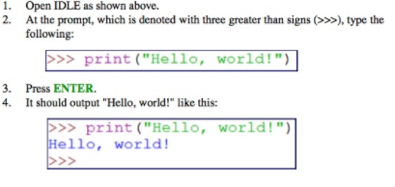
Introduction to Python
Module 1: Python Basics
Hello, World!

Slide 9

Introduction to Python
Module 1: Python Basics
Hello, World!
Run the following pre-written script:

Slide 10
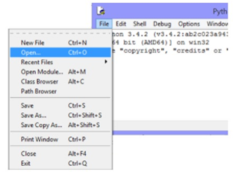
Introduction to Python
Module 1: Python Basics
Exercise 1: Hello, World!
1. Open the file in IDLE using File > Open:

Slide 11
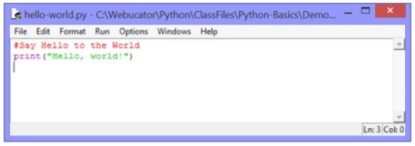

Introduction to Python
Module 1: Python Basics
Exercise 1: Hello, World!
2. It should appear like this:
3. Select Run>Run Module or press F5

Slide 12
Introduction to Python
Module 1: Python Basics
Literals
Literal = a value hard coded into an instruction
Python interpreter should not try to interpret it
Single quotes or double quotes can be used to create literals
Be sure to include the open and closed quotation marks

Slide 13

Introduction to Python
Module 1: Python Basics
Python Comments
The hash mark (or pound sign) indicates a comment
Everything after the hash mark on the same line is ignored
Multi-line strings can be used to create multi-line comments
Use triple quotes to create multi-line strings

Slide 14
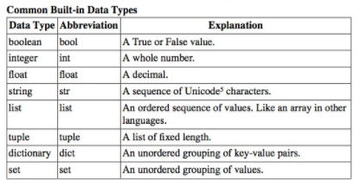
Introduction to Python
Module 1: Python Basics
Data Types
Data type determines
What an object can be
What can be done to it

Slide 15
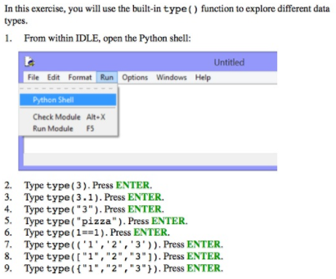
Introduction to Python
Module 1: Python Basics
Exercise 2: Exploring Types

Slide 16
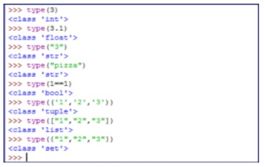
Introduction to Python
Module 1: Python Basics
Exercise 2: Exploring Types
Exercise Solution
The shell should appear as follows:

Slide 17
Introduction to Python
Module 1: Python Basics
Variables
Variables are untyped and do not need to be declared
Simply assign a value to a variable—Python determines the type by the value assigned
Variable Names are
Case sensitive
Conventionally written in all lowercase letters
Words are separated by underscores
Must begin with a letter or an underscore
May contain only letters, digits, and underscores

Slide 18


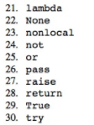

Introduction to Python
Module 1: Python Basics
Keywords

Slide 19

Introduction to Python
Module 1: Python Basics
Variable Assignment
Three parts to variable assignment
Variable name.
Assignment operator.
Value assigned. This could be any data type.

Slide 20

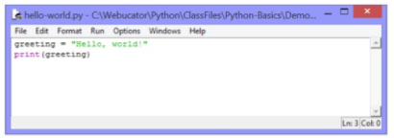
Introduction to Python
Module 1: Python Basics
Variable Assignment
To run this code:
Open the file in IDLE
Select Run>Run Module or press F5.

Slide 21
Introduction to Python
Module 1: Python Basics
Simultaneous Assignment
Python allows for simultaneous assignment.
Simultaneous assignment is useful as a shortcut for assigning several values at once.
Syntax follows:

Slide 22
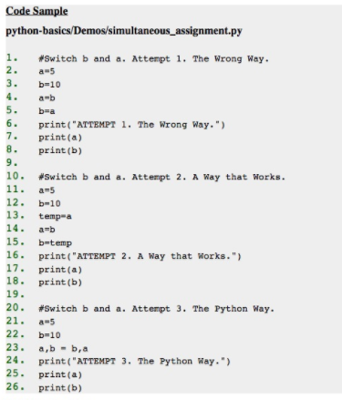
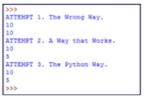
Introduction to Python
Module 1: Python Basics
Simultaneous Assignment
To run this code:
Open the file in IDLE
Select Run > Run Module or press F5.
The output is below

Slide 23
Introduction to Python
Module 1: Python Basics
Exercise 3: A Simple Python Script
In this exercise, you will write a simple Python script from scratch. The script will create a variable called today that stores the day of the week.
Open a new document using File > New and save it as today.py in the python- basics/Exercises folder.
Create a variable called today that holds the current day of the week as literal text (i.e., in quotes).
Use the print() function to output the variable value.
Test your solution.

Slide 24
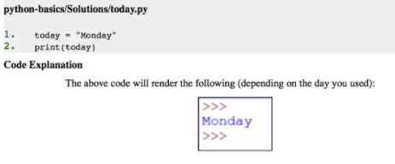
Introduction to Python
Module 1: Python Basics
Exercise 3: A Simple Python Script
Exercise Solution

Slide 25

Introduction to Python
Module 1: Python Basics
Constants
Python does not have constants, but it has variables that are meant to act like constants
Such variables are written in all capital letters

Slide 26

Introduction to Python
Module 1: Python Basics
Deleting Variables
Delete variable using the del statement

Slide 27
Introduction to Python
Module 1: Python Basics
Writing a Python Module
Python module is a file that contains reusable code
Module can be run by itself or as part of a larger program

Slide 28
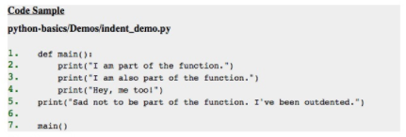
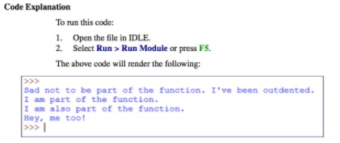
Introduction to Python
Module 1: Python Basics
The main () Function

Slide 29
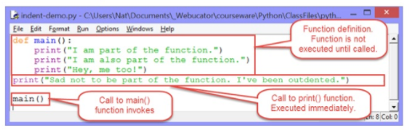
Introduction to Python
Module 1: Python Basics
The main () Function
Notes about function:
Functions are created using the def keyword.
The convention for naming functions is the same as that for variables: use all lowercase letters and separate words with underscores.

Slide 30
Introduction to Python
Module 1: Python Basics
The main () Function
Notes about function:
In the function definition, the function name is followed by a pair of parentheses, which may contain parameters (more on that later) and a colon.
The contents of the function starts on the next line and must be indented. Either spaces or tabs can be used for indenting, but spaces are preferred.

Slide 31
Introduction to Python
Module 1: Python Basics
The main () Function
Notes about function:
The first line of code after the function definition that is outdented is not part of the function. You'll learn that indenting matters to Python in other areas as well.
Functions are called (invoked) using the function name followed by the parentheses (e.g., indent_demo()).

Slide 32
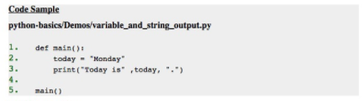
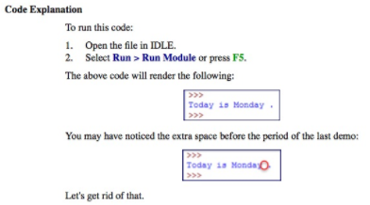
Introduction to Python
Module 1: Python Basics
print () Function

Slide 33
Introduction to Python
Module 1: Python Basics
Named Arguments
The last two arguments above are named arguments.
sep is short for "separator." It specifies the character that separates the list of objects to output. The default value is a single space, so specifying sep=" " doesn't change the default behavior at all.
end specifies the character to trail the printed objects. The default is a newline character (denoted with "\n"). You can use an empty quotation (e.g., "") to specify that nothing should trail the printed objects.

Slide 34
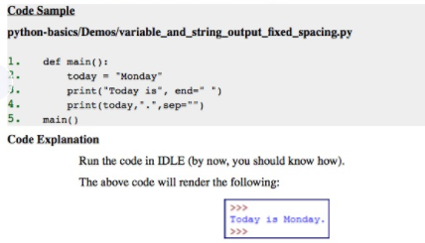
Introduction to Python
Module 1: Python Basics
Named Arguments

Slide 35
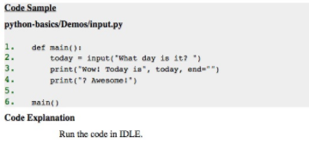
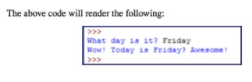
Introduction to Python
Module 1: Python Basics
Collecting User Input

Slide 36
Introduction to Python
Module 1: Python Basics
Exercise 4: Hello, You!
In this exercise, you will ...
Open a new script. Save it as hello_you.py in python-basics/Exercises.
Write code to prompt for the user's name.
After the user has entered his/her name, output a greeting.
Test your solution.

Slide 37
Introduction to Python
Module 1: Python Basics
Getting Help
Python has a built-in help ( ) function in the Python Shell.
Open the Python Shell from IDLE.
Type help() and press ENTER.
Type keywords and press ENTER. You should get a list of keywords in Python.
Type any one of the keywords and press ENTER. You should get documentation on that keyword.
To leave interactive help, type quit and press ENTER. You can also pass a value to the help() function when you call it.

Slide 38
Module 2: Functions and Modules

Slide 39
Objectives
SQL Injection Attacks and Defense
Module 2: Functions and Modules
Upon completion of this lesson, students will be able to do the following:
Define and call functions.
Define parameters in and pass arguments to functions.
Set default values for parameters.
About variable scope.
Return values from functions.
Create and import modules.

Slide 40

Introduction to Python
Module 2: Functions and Modules
Defining Functions
Functions are defined using the def keyword

Slide 41
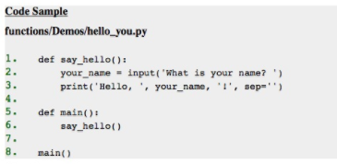
Introduction to Python
Module 2: Functions and Modules
Defining Functions
The code works in the same way, but the meat of the program has been moved out of the main() function and into another function. This is common. Usually, the main() function handles the flow of the program, but the actual "work" is done by other functions in the module.

Slide 42
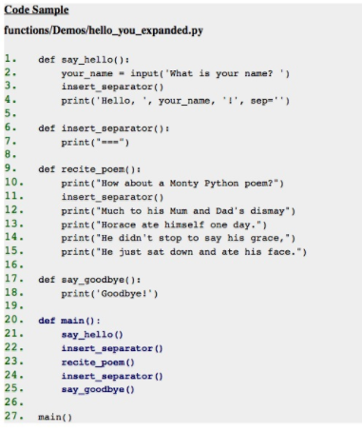
Introduction to Python
Module 2: Functions and Modules
Defining Functions

Slide 43
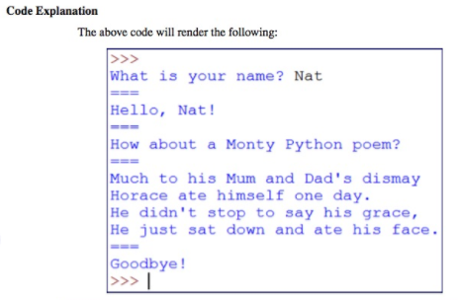
Introduction to Python
Module 2: Functions and Modules
Defining Functions

Slide 44
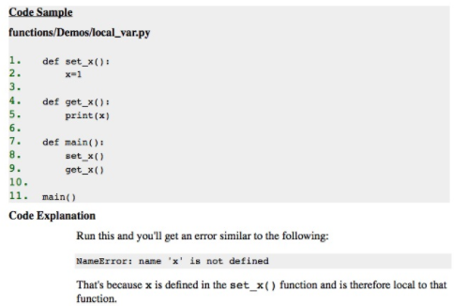
Introduction to Python
Module 2: Functions and Modules
Variable Scope

Slide 45
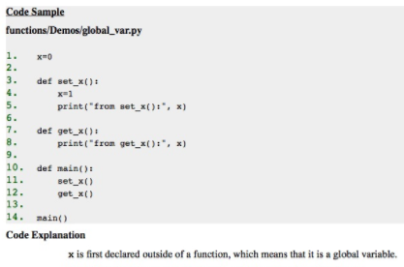
Introduction to Python
Module 2: Functions and Modules
Global Variables

Slide 46
Introduction to Python
Module 2: Functions and Modules
Global Variables
When a variable is referenced within a function, Python first looks for a local variable by that name. If it doesn't find one, then it looks for a global variable.
When a variable is assigned within a function, it will be a local variable, even if a global variable with the same name already exists.

Slide 47
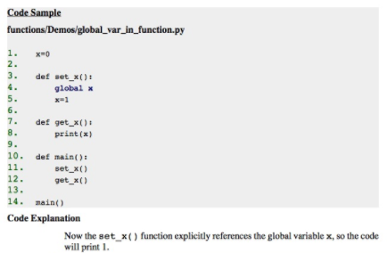
Introduction to Python
Module 2: Functions and Modules
Global Variables

Slide 48

Introduction to Python
Module 2: Functions and Modules
Function Parameters

Slide 49
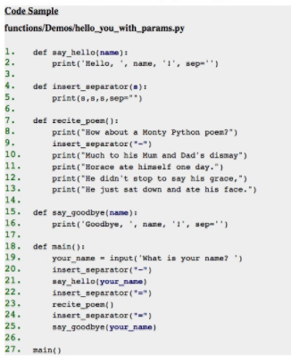
Introduction to Python
Module 2: Functions and Modules
Function Parameters

Slide 50
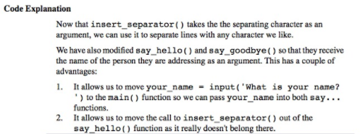
Introduction to Python
Module 2: Functions and Modules
Function Parameters

Slide 51
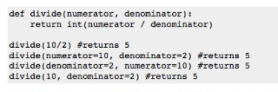
Introduction to Python
Module 2: Functions and Modules
Using Parameter Names in Function Calls
When calling a function, specify the parameter by name when passing in an argument. This is called passing in a keyword argument.

Slide 52
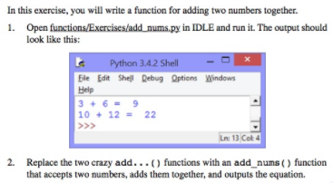
Introduction to Python
Module 2: Functions and Modules
Exercise 5: A Function with Parameters

Slide 53
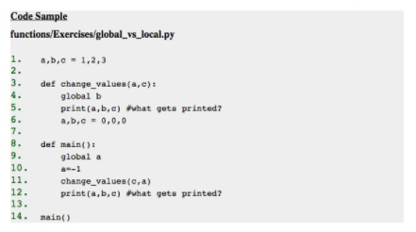
Introduction to Python
Module 2: Functions and Modules
Exercise 5: A Function with Parameters
Take a look at this code and see if you can figure out what will be printed out.

Slide 54
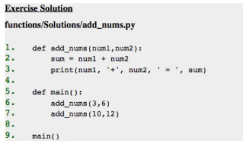
Introduction to Python
Module 2: Functions and Modules
Exercise 5: A Function with Parameters

Slide 55

Introduction to Python
Module 2: Functions and Modules
Exercise 5: A Function with Parameters

Slide 56

Introduction to Python
Module 2: Functions and Modules
Default Values
Parameters that do not have default values require arguments to be passed in.

Slide 57
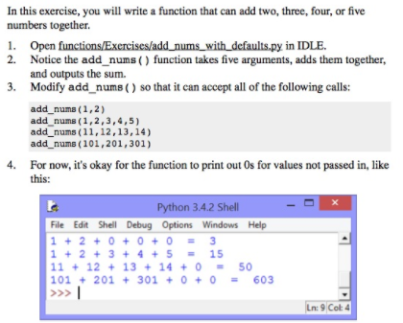
Introduction to Python
Module 2: Functions and Modules
Exercise 6: Parameters with Default Values

